Slide 1
Work and Energy

Slide 2
Learning outcomes
Students will be able to explain the scientific concept of work, and identify the
concept of positive, negative and zero work
They will be able to explain the relationship of force with work.
. They will be able to calculate the work done by any object in the absence or presence of force.
They will be able to explain and understand the basics of Energy, forms of energy, interconversion of energy and it’s relation with work.
They will be able to describe kinetic energy and potential energy by defining, deriving their formulae, their interconversion, examples and related numerical.
They will be able to elaborate law of conservation of energy with the help of examples to show that total energy is constant.
They will be able to explain concept of power and all related units.
They will be able to calculate electricity bill by concept of commercial unit of energy and hence in the long run learn to check misuse of energy in their surroundings.

Slide 3
Topics
Work
Zero, positive and negative work
Energy
Forms of energy
Kinetic energy
Gravitational potential energy
Elastic potential energy
Work energy transformation
Transformation of energy
Law of conservation of energy
Power
Commercial unit of energy

Slide 4
WORK IS DIFFERENT FROM WORKING HARD
Work in terms of Physics needs two conditions to be satisfied-
A force should act on an object & The object must be displaced.
Work is defined as the product of the force and displacement in the direction of force.
Work = Force× displacement
W = F × S

Slide 5
SI unit
W = F×S
= 1N × 1m
= 1 Joule
SI unit of work is joule.
1 Joule – When 1 Newton of force displaces an object through 1m in the direction of force,then the amount of work done is 1 Joule.
1 Joule = 1 N × 1 m
= 10⁵ dyne× 10² cm
= 10⁷ erg

Slide 6
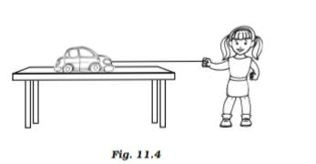
As force and displacement are acting along same direction i.e.angle between them is 0° Thus W = F × S

Slide 7
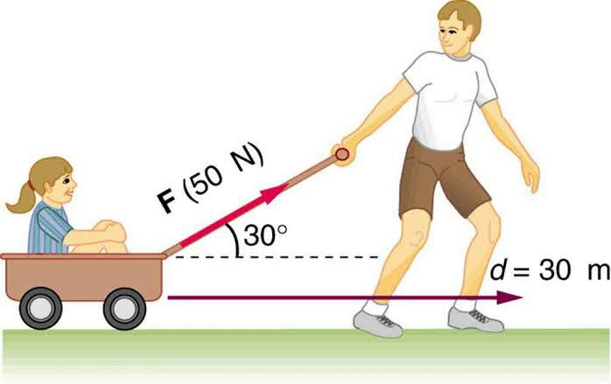
If force and displacement are not acting along same direction, then work done is equal to the product of force, displacement and the cosine of angle between them W = F × S cos θ

Slide 8
Zero Work
As W = F S cos θ
W = 0 , when either
F = 0
S = 0 OR
θ = 90°
F = 0
when no force is applied eg. Drawing diagram, organises her thoughts, collects question paper, doing meditation.

Slide 9
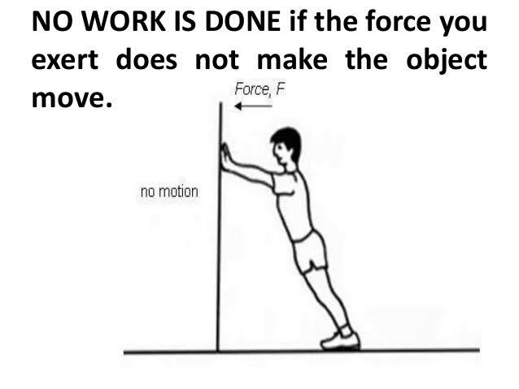
Work done is zero when, displacement is zero;
i.e. W = 0 when S = 0
eg. pushing a huge rock or wall

Slide 10
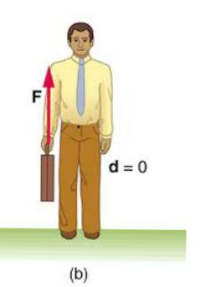
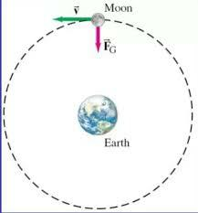
Moon when completes one revolution around the Earth then also displacement is zero.
So work done is zero
Man standing with a load on head, or holding a briefcase and waiting for a bus

Slide 11
When 0= 90° i.e.Angle between Force and displacement is 90°;force is perpendicular to the displacement.
Even when force and displacement are there but still work done is zero because they are perpendicular to each other.

Slide 12
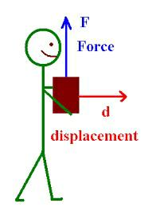
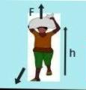
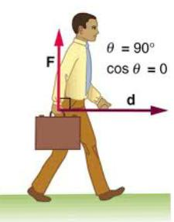
A man carrying suitcase and walking Or a coolie carrying luggage and walking

Slide 13
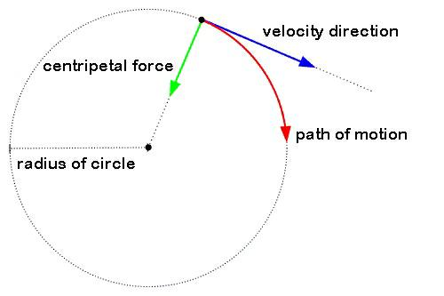
Work done by centripetal force is always zero as force and displacement are always perpendicular to each other.

Slide 14
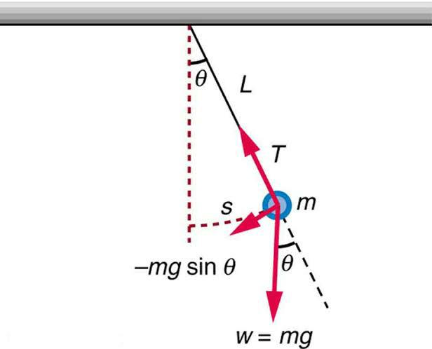
During motion of simple pendulum tension in the thread(force) is always perpendicular to the displacement of the Bob.
Work done by oscillating pendulum is always zero.

Slide 15
POSITIVE WORK
If force and displacement or Force& component of displacement are acting along same direction then the work done is positive.
W = F × S × cos θ
If 0≤θ<90°. i.e. Angle between force and displacement is acute then value of cos0 Is positive therefore work done is positive.

Slide 16
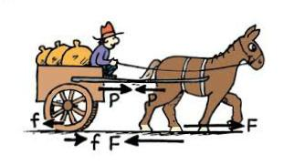
When a man pulls a cart or a horse pulls a cart. force and component of displacement are acting along same direction,thus here work is positive.

Slide 17
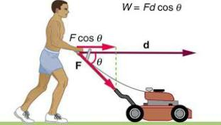
What about pushing?
Work done during pushing is negative or positive. As displacement and component of force is along same direction Work is again positive.

Slide 18
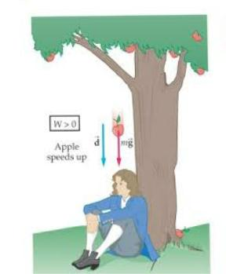
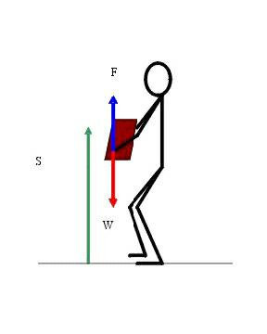
When force is applied to lift weight up, Force and displacement are acting in the same direction.
When a body falls freely under Gravitational pull, the work done by gravity is positive.

Slide 19
NEGATIVE WORK
Force and displacement or component of displacement are acting along opposite directions then the work done is negative.
W = F × S × cos θ
If 90<θ≤180°. i.e. Angle between force and displacement is obtuse then value of cosθ is negative therefore work done is negative.

Slide 20
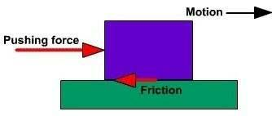
When a body is made to slide over a rough surface, the work done by frictional force(not the applied force)is negative.

Slide 21
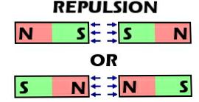
When a S/N pole repels S/N pole of another magnet, they move away from each other. The work done by magnetic force between them is negative.

Slide 22
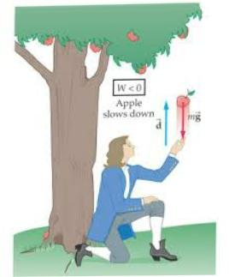
When a body is thrown up against gravitational pull, then work done by gravity is negative.

Slide 23
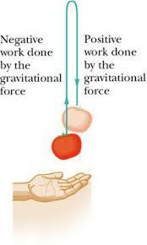
REFRESH THE CONCEPT

Slide 24
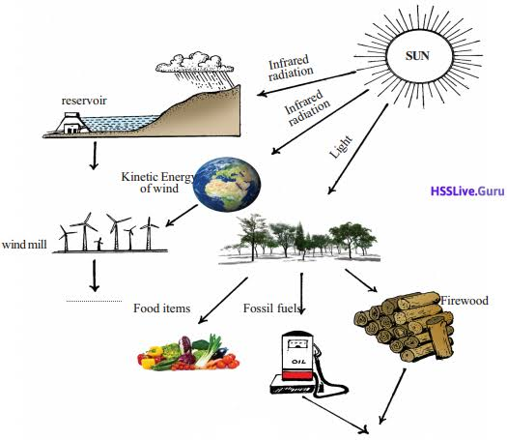
Energy
Different forms of energy

Slide 25
Different forms of energy
Kinetic Energy
Potential Energy
Chemical Energy
Heat Energy
Sound Energy
Light Energy
Electrical Energy
Solar Energy
Wind Energy
Ocean wave Energy
Ocean thermal Energy
Tidal Energy
Nuclear Energy
Geothermal Energy

Slide 26
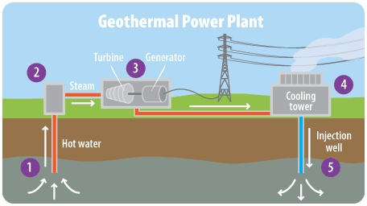
Geothermal energy is
the only energy source
which is directly or
indirectly not
related to the Sun.
Geothermal energy is actually due to heat inside the Earth.
It is utilised to produce electricity.

Slide 27
Facts related to Energy
Energy is defined as the capability of doing work.
The object which does the work loses energy and the object on which the work is done gains energy.
An object that possesses energy can exert a force on another object.
Thus any object that possesses energy can do work.
SI unit of energy is same as that of work i.e. Joule
1 J is the energy required to do 1 joule of work.

Slide 28
Kinetic energy-
It is the energy possessed by the body due to virtue of its motion
The Kinetic energy of an object increases with its speed.
A moving car, a flying aircraft, wind, moving fan, flowing water, running athletes, a cyclist rolling down on slope

Slide 29
Mathematical expression of KE
W = F × S
= m × a × S
= m × a × (v² – u² )/2a
= m × (v² – u² )/2
Work done is equal to the change in the kinetic energy of an object.
KE = m × (v² – u² )/2

Slide 30
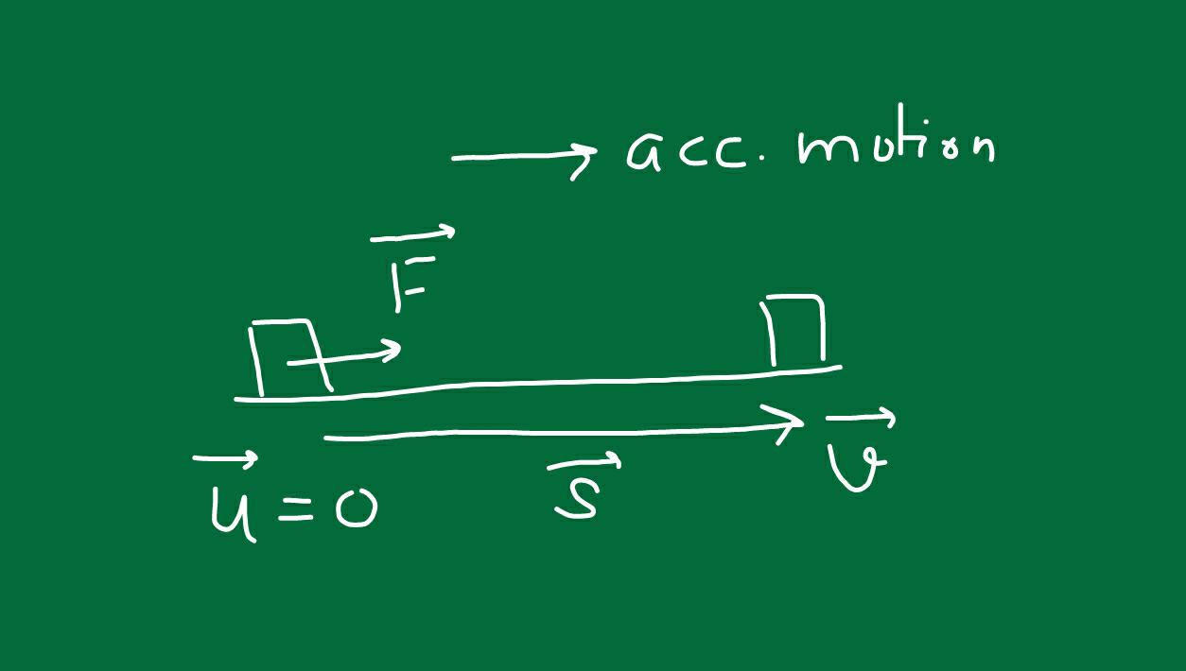
If the object is starting from rest i.e. u = 0, then
KE= m v² /2

Slide 31
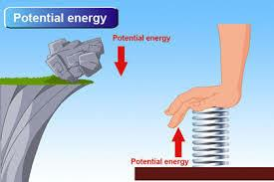
POTENTIAL ENERGY
Potential Energy is the energy possessed by the body due to virtue of its height above the earth surface,or its shape or configuration.
There are two types of potential energy:-
Elastic potential energy
Gravitational potential energy

Slide 33
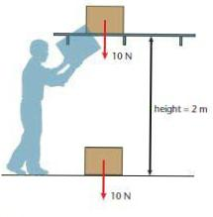
GRAVITATIONAL POTENTIAL ENERGY
Work is done on the mass m while it is being raised against gravity, then its energy increases.This energy is the GPE.
The GPE of an object at a point above the ground is defined as the work done in raising it from the ground to that point against gravity.

Slide 34
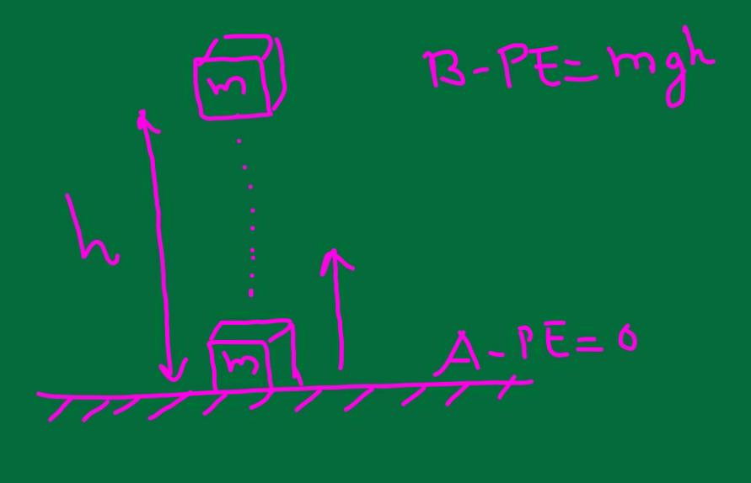
W = F × S
= mg × h
= mgh
Since work done is mgh, an energy equal to mgh is gained by the object in the form of gravitational potential energy.
PE = mgh

Slide 35
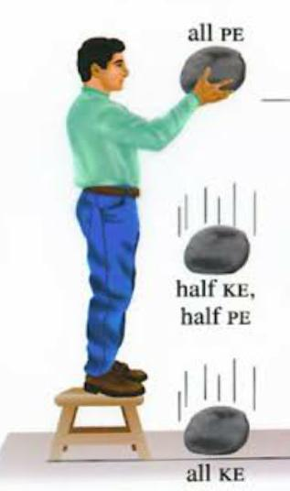
The work is done by the man against gravity,due to which the energy gets stored in the form of gravitational potential energy.
Man has to do large amount of work to raise it to a greater height,thus stored energy is also large.
Greater the height,larger will be the work,to get more GPE.

Slide 36
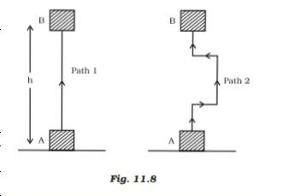
Work done by gravity depends on the difference in vertical heights of initial & final positions of the object & not on the path along which the object is moved.
PE = mgh PE = mgh

Slide 37
Elastic potential energy
The energy of a body due to a change in its shape and size is called elastic potential energy.
The change in shape of a body can be brought by compressing, stretching, bending, or twisting.
Work is done to change the shape of the body which gets stored in the deformed body in the form of form of elastic potential energy.

Slide 38
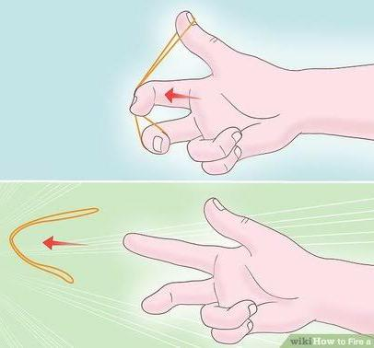
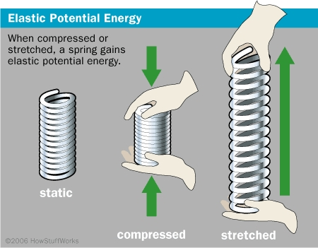
Work is being done on spring or rubber band while
stretching or compressing it, as it is not used to cause a
change in velocity or speed of an object,this work thus
gets stored in the form of elastic potential energy.

Slide 39
The Elastic potential energy stored in the bow due to the change of shape is thus used in the form of kinetic energy in throwing off the arrow

Slide 40
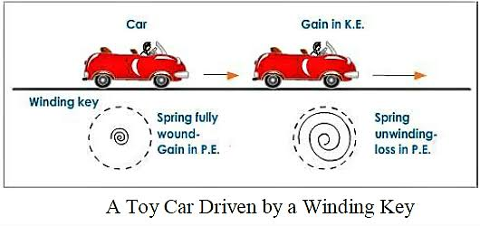
Work is done while winding the key of a toy car. The energy transferred to the spring inside is stored as EPE. When it unwinds itself EPE gets converted into kinetic energy.

Slide 41
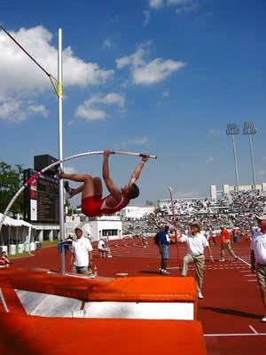
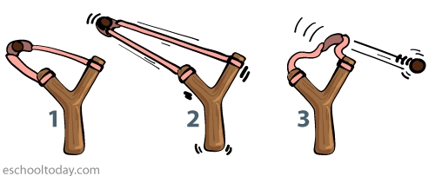
Law of conservation of energy
Law of conservation of energy states that energy remains conserved, it can neither be created nor be destroyed.

Slide 42
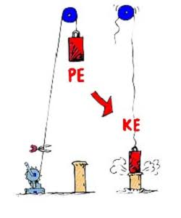
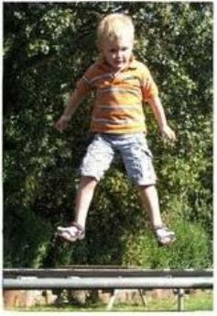
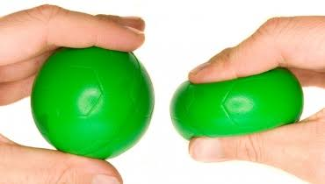
This simply indicates that energy can be transformed from one form to another but the sum total of the energy remains constant.

Slide 43
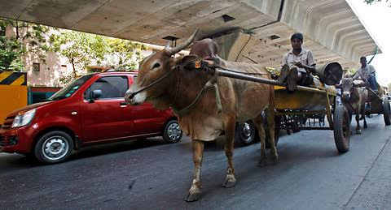
Power
Power is defined as rate of doing work OR rate of transfer of energy.
Power measures the speed of work done,i.e. how fast or slow work is done.
Power = work/ time
SI unit P = W/ t.
= J/ s.
= Watt
SI unit of power is watt.

Slide 44
OTHER UNITS OF POWER
1 kW = 1000 watt
1MW = 10⁶ Watt
1 HP = 746 wtt
1 Watt – 1 Watt is the power of an agent, which does work at the rate of 1 joule per second.
AVERAGE POWER
The power of an agent may be doing work at different rates at different intervals of time.
Thus average power is used which is total energy consumed per unit total time taken.

Slide 45
Commercial unit of energy
For the bigger unit ,as joule is very small unit,we use kwh
1 kWh is the energy used in one hour at the rate of 1000J/ s
1 kWh = 1kw × 1 hour
= 1000w × 3600 sec
= 3600000 J
= 3.6 × 10⁶ J

Slide 46
The energy used in households , industries, and commercial establishments are usually expressed in kWh So,
3.6 × 10⁶ J = 1kwh
= 1 Board of trade unit
= 1 commercial unit
= 1 unit.

Slide 47
Summary
Definition of Work its meaning SI unit and CGS unit.
Illustrations of different type of work from day to day life.
Discussions of different type of work positive, zero and negative work with examples.
Different forms of energy and their origin from where they are derived.
Kinetic energy and Potential energy, their definitions, derivations and examples to illustrate these two energies in detail.
Transformation of energy from one form to another.
Law of conservation of energy and its simple applications.
Power definition and SI unit, its formula,
Commercial unit of energy.

Slide 48
Reference
NCERT Text book Class IX
Exampler Problems Science

